Slide 1
AI-Based Timetable Generation System aligned with NEP 2020 for Multidisciplinary Education Structures
CSE7101- Capstone Project
Review-2
Batch Number: COM_14
Under the Supervision of,
Ms.Babitha S
Assistant Professor
School of Computer Science and Engineering
Presidency University
20221COM0019 | Makandar Saba Fareen
20221COM0039 | Billa Sunilkumar
20221COM0052 | Pikkili Sai Tarishma
Roll Number | Student Name
Name of the Program: COM
Name of the HoD: Dr. Gopal Krishna Shyam
Name of the Program Project Coordinator: Ms. Sumita Guddin
Name of the School Project Coordinators: Dr. Sampath A K , Dr. Geetha A

Slide 2
Content
Abstract
Problem Statement
Objectives
Literature Survey
Proposed Methodology
Modules
Implementation Progress

Slide 3
Content
Software and Hardware Components
SDG Mapping
Innovation / Novel Contributions
Timeline (Gantt Chart)
References

Slide 4
Abstract
The National Education Policy (NEP) 2020 has introduced multidisciplinary and flexible academic programs such as B.Ed., M.Ed., and Four-Year Undergraduate Programmes (FYUP), increasing the complexity of academic timetable preparation. Managing multiple programs, shared faculty, and limited infrastructure through manual scheduling is inefficient and prone to conflicts, highlighting the need for an automated timetable generation system.
This project proposes a web-based timetable generation system aligned with NEP 2020 that supports program-wise scheduling. The system enables input of course, faculty, and room details and generates separate timetables for each academic program using rule-based intelligent scheduling. By ensuring program-specific filtering and resource mapping, the system provides a scalable foundation for future AI-based optimization and backend integration.

Slide 5
Problem Statement
NEP 2020 introduces multidisciplinary and flexible academic structures
Multiple programs require separate, conflict-free timetables
Manual timetable preparation is time-consuming and prone to errors
Difficulty in managing faculty, courses, and classrooms efficiently
Lack of program-wise filtering and automation in traditional systems
Need for a centralized and scalable timetable generation solution

Slide 6
Objectives
To design an automated timetable generation system compliant with NEP 2020
To support multiple academic programs such as B.Ed., M.Ed., FYUP, and ITEP
To enable program-wise course, faculty, student, and room management
To generate conflict-free timetables based on available resources
To provide filtering of timetables based on selected programs
To reduce manual effort and errors in timetable preparation
To develop a scalable frontend architecture with future backend and AI integration
To improve transparency and usability through an interactive web-based interface

Slide 7
Literature Survey
A review of existing research and techniques related to automated and AI-based timetable generation systems.
Sl. No | Authors & Reference Title | Year | Benefits | Limitations
1 | N. R. Joshi and T. V. Agarwal, Optimizing University Course Timetabling Using Constraint Satisfaction Models | 2023 | Uses constraint satisfaction to reduce timetable conflicts and improve scheduling efficiency | Limited scalability for large multidisciplinary institutions
2 | R. P. Badoni et al., Metaheuristic Approach for University Course Timetabling Problems | 2023 | Combines exploration and exploitation strategies for better optimization | High computational cost and complexity
3 | Wren, A., Scheduling, Timetabling and Rostering — A Special Relationship | 1996 | Establishes theoretical foundations for automated timetabling | Lacks modern AI and computational techniques
4 | V. Shah et al., Optimizing Timetable Generation Using Genetic Algorithm | 2025 | Genetic algorithms provide optimized and flexible timetable solutions | Requires careful parameter tuning and longer execution time

Slide 8
5 | A Survey Paper on Timetable Generator Using AI Methods | 2025 | Reviews multiple AI-based approaches and highlights research trends | Does not implement or evaluate a real system
6 | X. Han and D. Wang, Gradual Optimization Using GA and Dynamic Programming | 2025 | Hybrid approach improves optimization accuracy | Increased system complexity and resource usage
7 | Z. Bratković et al., University Course Timetabling with Genetic Algorithm | 2009 | Demonstrates GA effectiveness in academic scheduling scenarios | Focused on limited use cases (laboratory exercises)
8 | A. Muklason et al., Tabu–Simulated Annealing Hyper-Heuristics | 2024 | Reduces conflicts using hybrid heuristic optimization | Algorithm complexity makes real-time implementation difficult
9 | A. R. Mahlous and H. Mahlous, Student Timetabling Genetic Algorithm | 2023 | Supports data-driven agricultural planning | Increased constraints reduce optimization flexibility
10 | E. K. Burke & S. Petrovic, Recent Research Directions in Automated Timetabling | 2002 | Provides a foundational review of automated timetabling methods and constraint-based approaches. | Lacks support for modern AI techniques and multidisciplinary education requirements.

Slide 9
Proposed Methodology
1.Data Collection (NEP 2020 Aligned)
Collect course structures, credits, programs (B.Ed., M.Ed., FYUP), faculty workload, and room availability.
2.Data Preprocessing & Feature Preparation (AI Step)
Convert academic data into machine-readable features such as course hours, faculty load, program type, and room capacity.
3.Constraint Modeling
Define hard constraints (no clashes, credit limits) and soft constraints (balanced workload, optimized room usage).
4.AI-Assisted Scheduling Logic
Use heuristic/AI-inspired decision logic (rule-based optimization with adaptive selection) to assign courses to slots.
5.Program-wise Timetable Generation
Generate separate timetables for each program to support multidisciplinary education.

Slide 10
Proposed Methodology
6.Conflict Detection using Intelligent Rules
Automatically detect conflicts using constraint checks and reassign slots dynamically.
7.Optimization & Refinement (AI Aspect)
Iteratively improve the timetable by minimizing idle slots and balancing faculty workload.
8.Timetable Visualization
Display the finalized timetable in a user-friendly tabular format.
9.Filtering and User Interaction
Allow users to filter timetables by program, faculty, or room.
10.Output Generation (Future Scope)
Support export of optimized timetables to PDF/Excel formats.

Slide 11
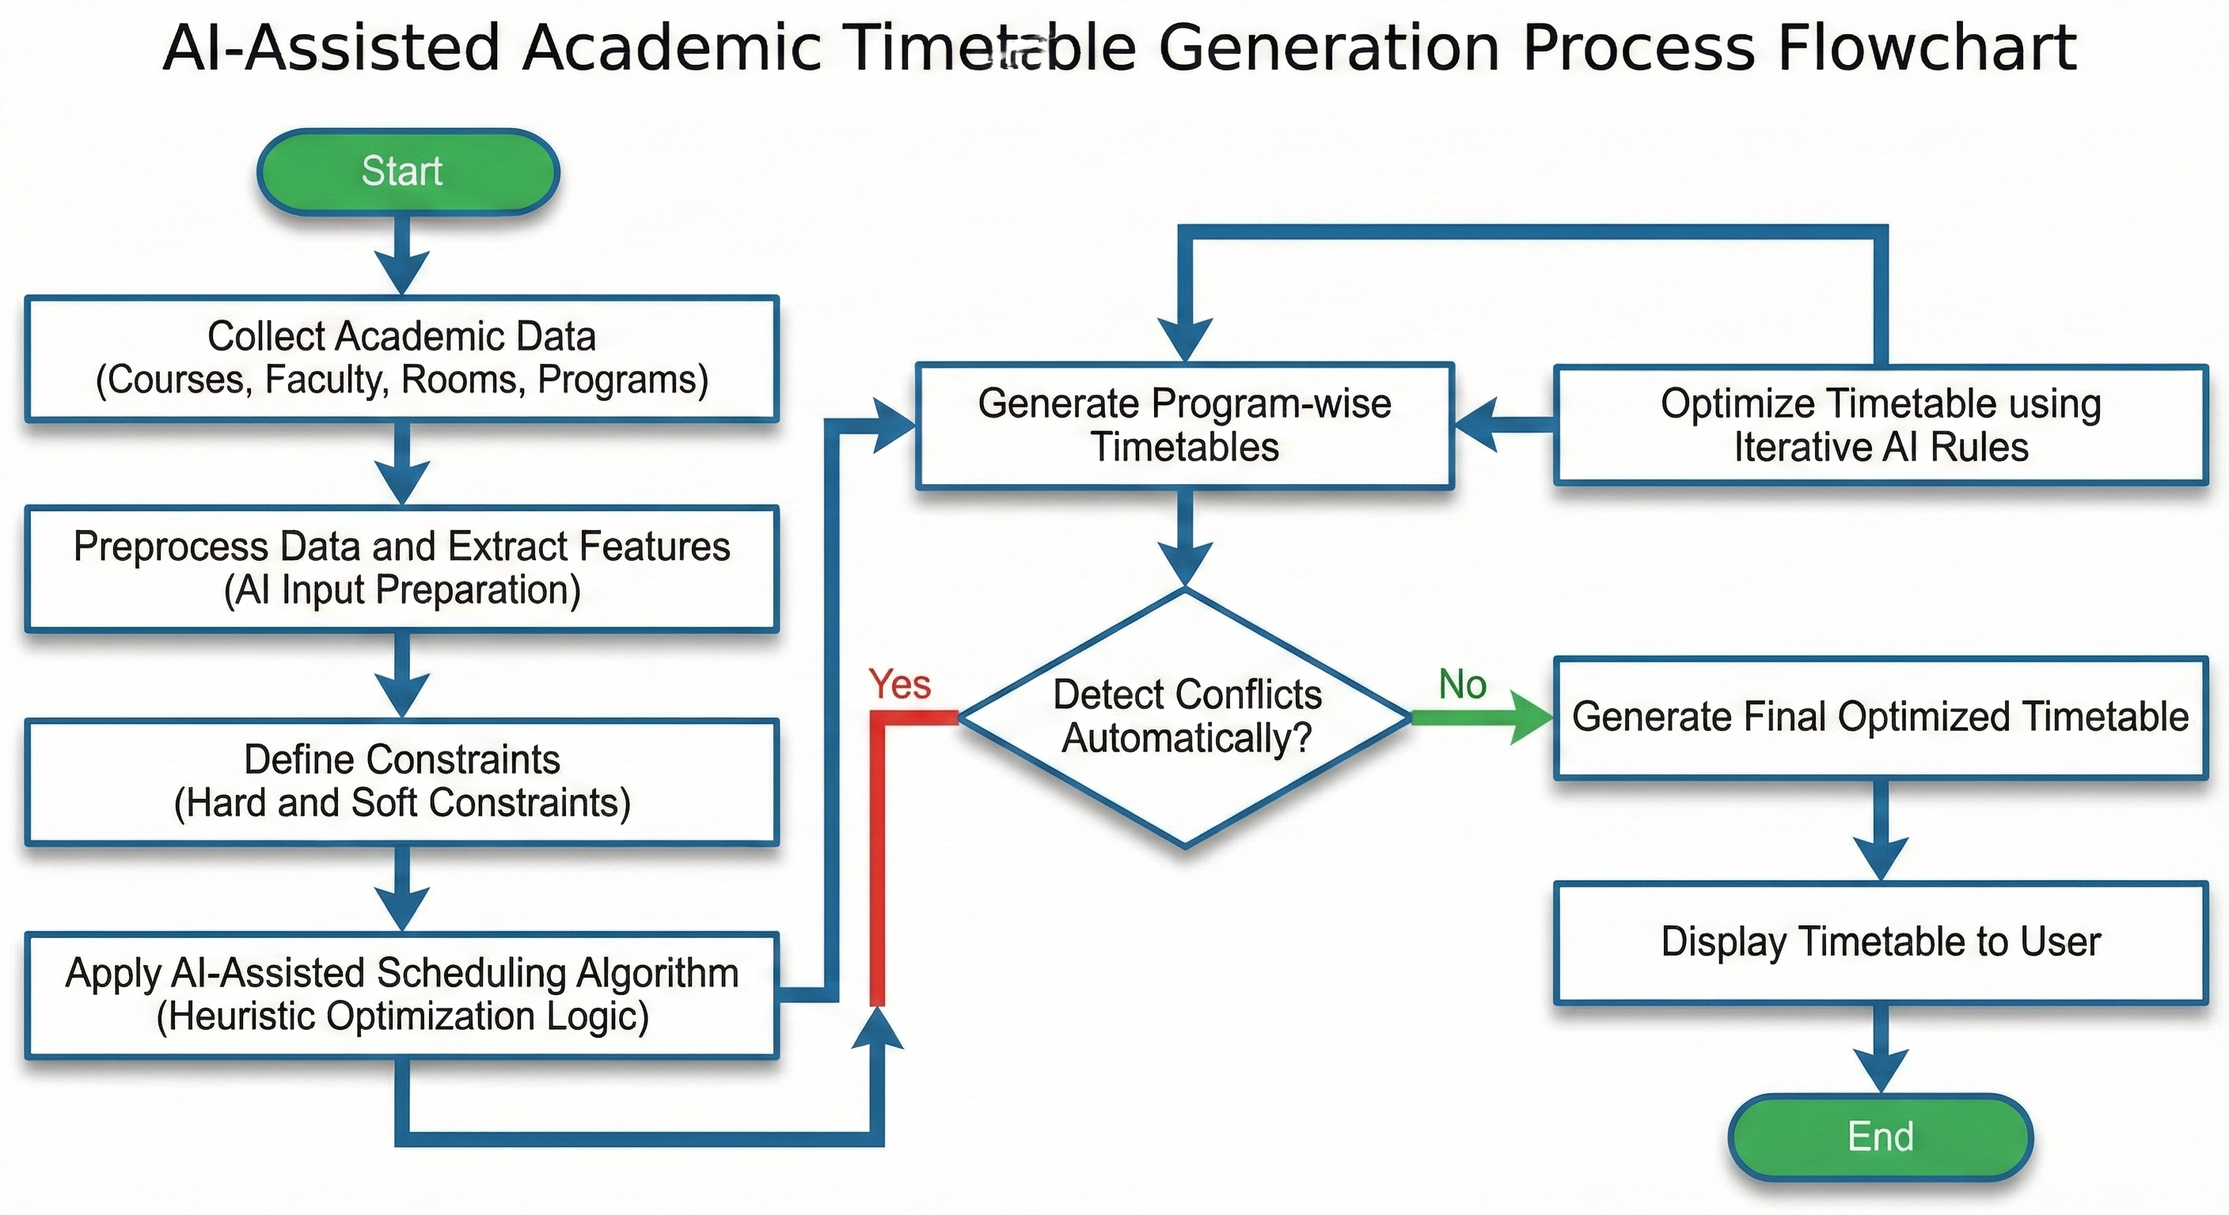
Proposed Methodology
Flowchart

Slide 12
Modules
1. Frontend User Interface Module
Handles user interaction, data input, and timetable visualization.
Component: Frontend (HTML, CSS, JavaScript)
2. Academic Data Management Module
Manages course, faculty, student, program, and room data.
Performs basic validation and structured storage.
Component: Frontend (JS data structures)
(Backend database – future scope)
3. Constraint Modeling Module
Defines and enforces hard constraints such as no clashes, program separation, credit limits, and room capacity.
Component: Frontend Logic (JavaScript)

Slide 13
Modules
4. AI-Assisted Scheduling & Optimization Module
Uses heuristic-based intelligent logic to allocate courses, faculty, and rooms into time slots.
Iteratively refines timetable to reduce conflicts and balance workload.
Component: Frontend Scheduling Engine
(Backend AI engine – future enhancement)
5. Timetable Generation & Visualization Module
Generates program-wise timetables and displays them in a structured format.
Supports filtering by program and academic parameters.
Component: Frontend (JS + UI Rendering)

Slide 14
Implementation Progress
1.System Setup & UI Development
Developed a web-based user interface using HTML, CSS, and JavaScript.
2.Academic Data Management
Implemented client-side data structures to manage courses, faculty, students, and rooms.
3.Constraint Definition
Defined scheduling constraints such as program-wise segregation and conflict avoidance.
4.AI-Assisted Timetable Generation
Applied heuristic-based intelligent logic to generate optimized, conflict-free timetables.
5.Timetable Visualization & Filtering
Displayed generated timetables with program-wise filtering for user interaction.

Slide 15
Hardware & Software Requirements
Hardware Requirements:
System: Desktop / Laptop
Processor: Intel i3 or higher
RAM: Minimum 4 GB
Storage: 5 GB free disk space
Display: Standard monitor (for UI visualization)
Software Requirements
Operating System: Windows / Linux / macOS
Programming Languages:
1.HTML5, CSS3 (Frontend UI)
2.JavaScript (Logic & Scheduling)
Code Editor: Visual Studio Code
Web Browser: Google Chrome / Mozilla Firefox

Slide 16
SDG Mapping
SDG 9 – Industry, Innovation and Infrastructure
Encourages the use of AI-assisted and digital solutions in academic administration.
Promotes innovation in institutional planning through software-based systems.

Slide 17
Innovation / Novel Contribution:
NEP 2020–Compliant Design: Supports multidisciplinary and program-wise academic structures.
AI-Assisted Scheduling: Uses heuristic-based intelligent logic for automated timetable generation.
Program-wise Timetables: Generates separate timetables for each academic program.
Dynamic Data Input: Allows real-time entry of courses, faculty, and rooms via web interface.
Scalable Architecture: Supports future backend and advanced AI/ML integration.

Slide 18
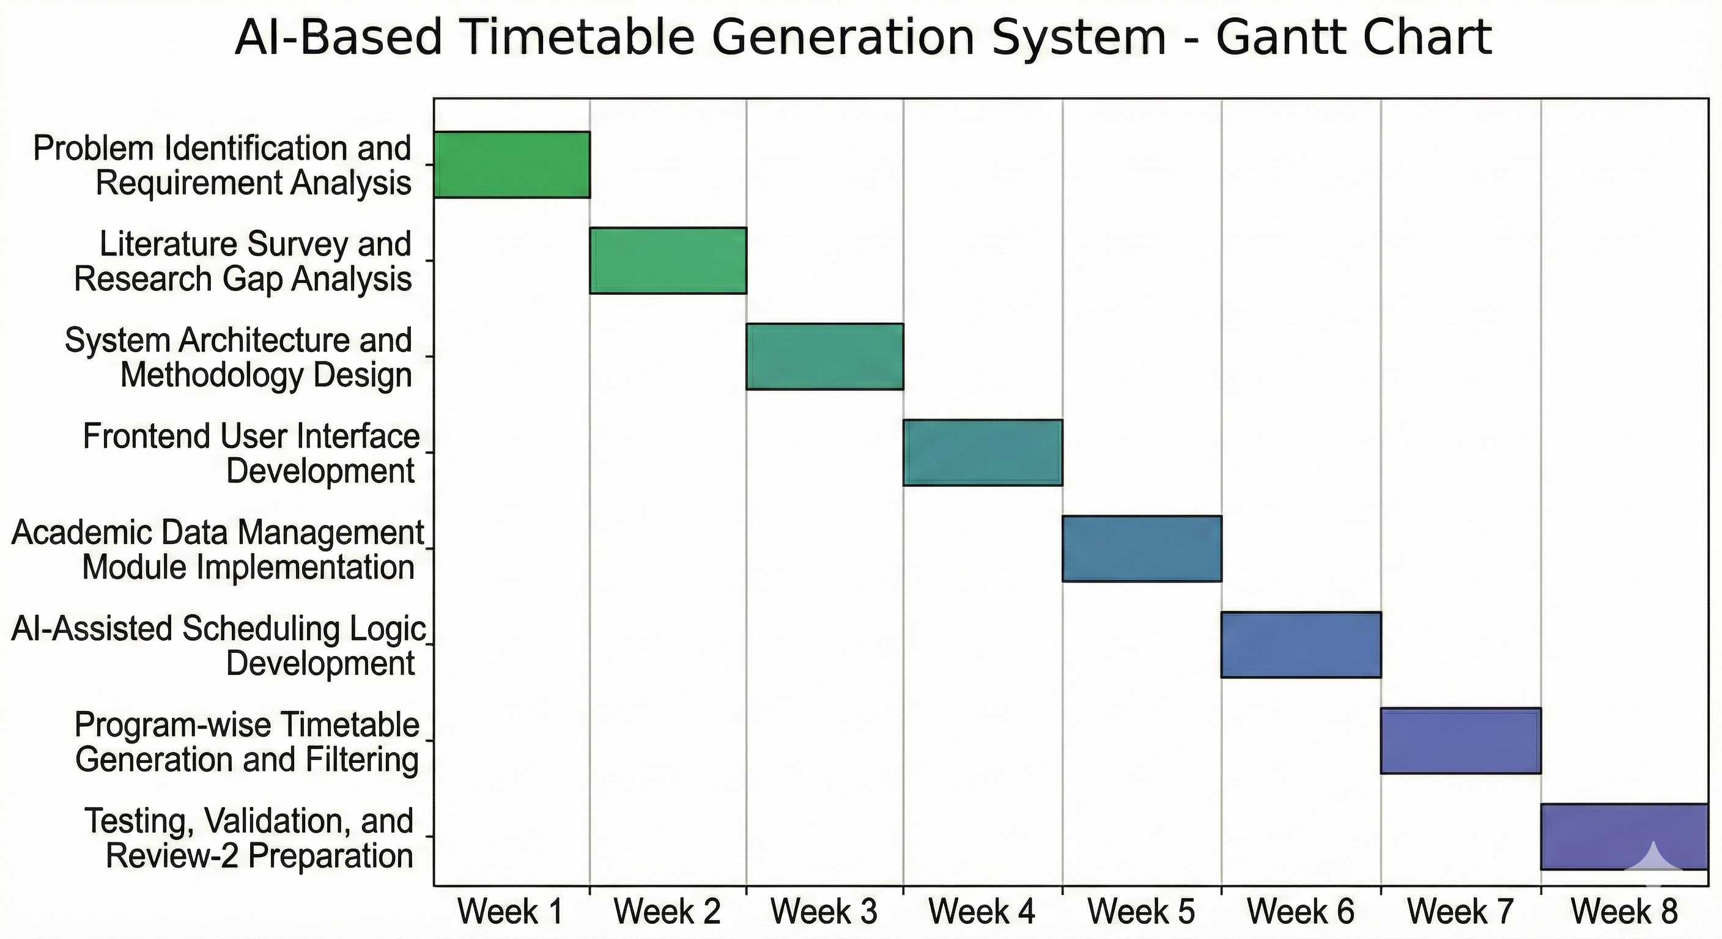
Timeline (Gantt Chart)

Slide 19
Github Link
The Github link provided should have public access permission.
Github Link
https://github.com/Tarishmapikkili/AI-Based-Timetable-Generation-System

Slide 20
References
[1] N. R. Joshi and T. V. Agarwal, “Optimizing University Course Timetabling Using Constraint Satisfaction Models,” International Academic Journal of Science and Engineering, vol. 10, no. 4, pp. 5–8, Dec. 2023.
DOI: https://doi.org/10.71086/IAJSE/V10I4/IAJSE1032
[2] R. P. Badoni et al., “An Exploration and Exploitation-Based Metaheuristic Approach for University Course Timetabling Problems,” Axioms, vol. 12, no. 8, p. 720, Jul. 2023.
DOI: https://doi.org/10.3390/axioms12080720
[3] Wren, A. (1996). Scheduling, timetabling and rostering — A special relationship?. In: Burke, E., Ross, P. (eds) Practice and Theory of Automated Timetabling. PATAT 1995. Lecture Notes in Computer Science, vol 1153. Springer, Berlin, Heidelberg. https://doi.org/10.1007/3-540-61794-9_51

Slide 21
References
[4] V. Shah, A. Gadhvi, N. Oza, M. Sankhe, and M. Mangla, “Optimizing Timetable Generation for Educational Institute Using Genetic Algorithm,” in Proceedings of the International Conference on Recent Advances in Sustainable Intelligent Technology Applications (RAMSITA 2025), 2025.
DOI: https://doi.org/10.2991/978-94-6463-716-8_37
[5] “A Survey Paper on Timetable Generator Using AI Methods,” International Research Journal of Advanced Engineering Hub, vol. 3, no. 03, pp. 860–864, Mar. 2025.
DOI: https://doi.org/10.47392/IRJAEH.2025.0122
[6] X. Han and D. Wang, “Gradual Optimization of University Course Scheduling Problem Using Genetic Algorithm and Dynamic Programming,” Algorithms, vol. 18, no. 3, p. 158, 2025.
DOI: https://doi.org/10.3390/a18030158

Slide 22
References
[7] Z. Bratković, T. Herman, V. Omrčen, M. Čupić, and D. Jakobović, “University Course Timetabling with Genetic Algorithm: A Laboratory Exercises Case Study,” in Evolutionary Computation in Combinatorial Optimization (EvoCOP 2009), Lecture Notes in Computer Science, vol. 5482. Springer, 2009.
DOI: https://doi.org/10.1007/978-3-642-01009-5_21
[8]A. Muklason, A. Marom, and I. G. A. Premananda, “Automated Course Timetabling Optimization Using Tabu-Simulated Annealing Hyper-Heuristics Algorithm,” Khazanah Informatika: Jurnal Ilmu Komputer dan Informatika, vol. 10, no. 1, 2024.
DOI : https://doi.org/10.23917/khif.v10i1.4835
[9] A. R. Mahlous and H. Mahlous, “Student Timetabling Genetic Algorithm Accounting for Student Preferences,” PeerJ Computer Science, vol. 9, p. e1200, Feb. 2023.
DOI: https://doi.org/10.7717/peerj-cs.1200

Slide 23
References
[10] E. K. Burke and S. Petrovic,
“Recent research directions in automated timetabling,” European Journal of Operational Research, vol. 140, no. 2, pp. 266–280, Jul. 2002.
DOI: https://doi.org/10.1016/S0377-2217(02)00069-3

Slide 24


